Slide 1
Evidence Acquisition and Reports
Digital Forensics Day 3

Slide 2

Class Objectives
By the end of class, you will be able to:
Use Autopsy to access and gather evidence from emails.
Use data exports to analyze email and SMS messages offline.
Use Autopsy to extract GPS data and identify WiFi locations.
Prepare a preliminary report of the 2012 National Gallery Case.

Slide 3

As a forensic investigator, it’s critical that you understand how to use tools such as Autopsy and know how to export data so other team members can perform offline analysis of evidence.
Notes:
shutterstock_1156921555

Slide 4

The .emlx is a file extension called Mail Message that’s used to store email messages.
EMLX files are often referred to as Apple Mail files because they are created with Apple’s mail program to store plain text files for a single message.
Notes:
shutterstock_1248126409

Slide 5
Activity: Email Export
In this warm-up activity, you will export the email database for offline analysis using examination tools outside of Autopsy.
15 Minutes

Slide 6
Tracy’s Email Evidence

Slide 7

Now we’ll use offline analysis to uncover details of the National Gallery case.
7

Slide 8

Email Evidence
We can extract the following evidence from emails:
01
Sender’s email address
02
Sender’s IP address
03
Internet Service Provider (ISP)
04
User client (the email app)
05
Location information
Notes:
shutterstock_1171657165

Slide 9

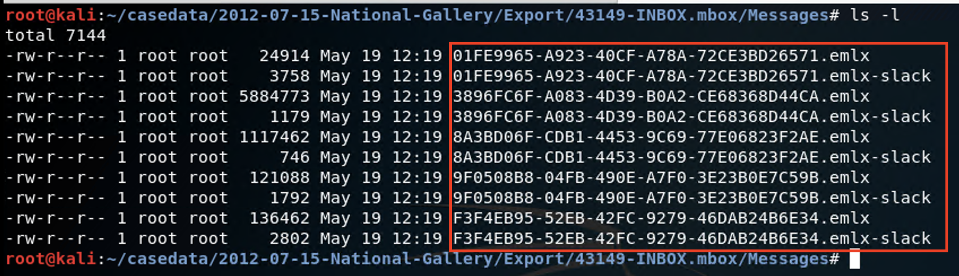
Examining Emails in Kali Linux
Displaying email messages in the INBOX.mbox/Messages folder is as simple as running the ls -s command.
From there, we’ll use Nano to display the contents of each EMLX file.
(Source)

Slide 10

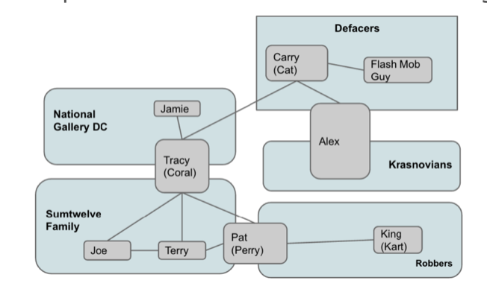
Evidence in the Emails
This diagram provides a high-level overview of the threat actors’ involvement in the 2012 case.
As you analyze the emails, use this as a roadmap to tie Tracy’s associates to each incident.
National Gallery DC
Defacers
Carry (Cat)
Jamie
Flash Mob Guy
Tracy (Coral)
Krasnovians
Sumtwelve Family
Alex
Robbers
Pat (Perry)
King (Kart)
Joe
Terry
Notes:
shutterstock_191467574

Slide 11
Correspondence Evidence Worksheet
In the next activity, you will use the following worksheet:
Correspondence Evidence Worksheet
Artifact numbers to help organize records
Timestamp (time email was sent or received)
Header information
Including names of the individuals involved, their email addresses, and the email subject line.
Key information
Summary of email contents
Evidence location
Source of the data

Slide 12
Activity: Tracy’s Email Evidence
In this activity, you will use Autopsy to access Tracy’s email correspondence and generate a list of contacts and their email addresses.
45 Minutes

Slide 14

Notes:
Image source: AdobeStock_56885471

Slide 15
Tracy’s SMS Messages

Slide 16

We were able to identify an email attachment called needs.txt containing a list of tools intended to assist with carrying out the crime.
We’ll continue to search for more evidence by examining Tracy’s SMS messages.

Slide 17



SMS
SMS ("short message service") messages are what you know as text messages. They are a person-to-person communication method.
SMS messages can be no more than 918 characters.
SMS messages can and have been used in DoS attacks.
Notes:
Shutterstock_1008237121 Shutterstock_535531051

Slide 18

Smishing refers to a social engineering attack performed using SMS messages.
18

Slide 19

In the following demonstration, we’ll go through different ways of examining SMS entries.
(Source)

Slide 20
Activity: Tracy’s SMS Messages
In this activity, you will work with your group to examine Tracy’s SMS messages and gather more information about the case.
15 Minutes

Slide 22

In the final activity, you will conclude your investigation by working in groups to present your findings in a final report.

Slide 23
Unit Recap
We’ve examined a lot of information and done the following:
Performed mobile forensic analysis and compiled details of Tracy’s iPhone.
Searched through numerous files and directories on the iPhone image.
Tagged and categorized evidence relevant to the case.
Created custom tags.
Extracted data for offline analysis using the export function.
Examined and documented Tracy’s emails.
Examined and documented Tracy’s SMS messages.

Slide 24
Activity: The Final Report
In this activity, you will start preparing the report of your group’s findings. The report will be continued as part of your homework.
25 Minutes

Slide 26
You’ll continue your report and work on another bonus assignment for homework.
26

Slide 27

Digital Forensics Wrap-Up
Digital forensics is a field dedicated to identifying, extracting, preserving, and reporting information obtained from computer and network systems.
Digital forensics relies on the expertise of examiners to analyze and interpret data using trusted forensic examination tools.
Investigative teams may be spread across several time zones, so it's important to follow a standard time zone, as indicated in the case file.
27
27

Slide 28
Questions?

